Slide 1


Data Analytics Project Recap For Social Buzz

Slide 2


Today's agenda
Project recap
Problem
The Analytics team
Process
Insights
Summary

Slide 3

Client: Social Buzz
Industry: Social media & content creation
Project Duration: 3 months
Client Background: Social Buzz emphasizes content by keeping all users anonymous, only tracking user reactions to every piece of content.
Project Recap

Slide 4

Over the past 5 years, the Company has reached over 500
million active users each month. Every day 10,000 pieces of
Highly unstructured data is generated.
Key Issues:-
1. Difficulty in managing and maintaining all the complex data.
2. Scaling complexity
Problem statement:- An analysis of their content categories that
highlights the top 5 categories with the largest aggregate
population.
Problem

Slide 5
Andrew Fleming
Chief Technology Architect
The Analytics team
Marcus Rompton
Senior Principal
Myself
Data Analyst

Slide 6
Process
1
Understanding Brief
2
Data Cleaning
3
Data Modeling
4
Data Analysis
5
Sharing Insights

Slide 7

Insights
16 Unique Categories among which the top 5 categories have the highest Popularity scores.
The Animal category received 1,897 reactions, representing 21% of total interaction
May month has had the highest volume of posts i.e. 2138, indicating increased user activity or content generation during this period.
1
2
3

Slide 8
Insights charts

Slide 9
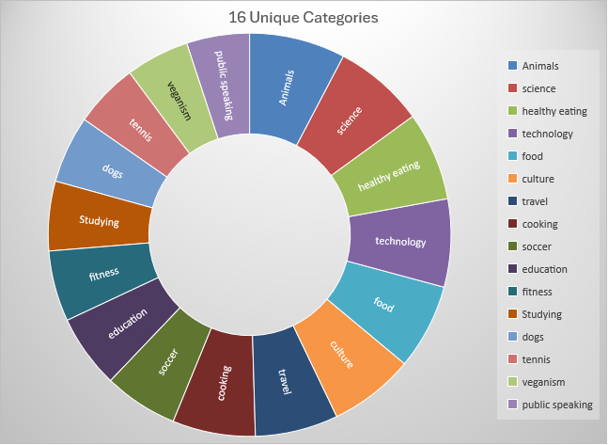
Insights charts

Slide 10

The Animal category is a major driver of user engagement, suggesting potential for increased content production in this area.
The peak activity in May highlights heightened user interaction, which could be leveraged for targeted marketing or content strategies in future campaigns.
Summary

Slide 11
Thank you!
ANY QUESTIONS?

